Slide 1
Principles of Anatomy and Physiology
Gerard Tortora and Bryan Derrickson
Sixteenth Edition
Chapter 2
The Chemical Level of Organization
This slide deck contains animations. Please disable animations if they cause issues with your device.
Copyright ©2021 John Wiley & Sons, Inc.

Slide 2
Introduction
The purpose of this chapter is to:
Introduce the language and fundamental concepts of chemistry
Discuss how matter is organized
Discuss how chemical bonds form and how chemical reactions occur
Compare and contrast organic and inorganic compounds

Slide 3
How Matter Is Organized

Slide 4
Basic Principles of Chemistry
Chemistry is the science of structure and interactions of matter
Matter is anything that has mass and takes up space
Mass is the amount of matter in an object, whereas weight is the force of gravity acting on a mass

Slide 5
Chemical Elements
Matter exists in 3 forms:
Solid
Liquid
Gas
All forms of matter are composed of chemical elements

Slide 6
Elements
Elements are given chemical symbols such as:
O = oxygen
C = carbon
H = hydrogen
N = nitrogen
These elements make up the majority of our bodies

Slide 7
Main Chemical Elements in the Body
Chemical Element (Symbol) | % of Total Body Mass | Significance
Major Elements | (about 96) | Blank
Oxygen (0) | 65.0 | Part of water and many organic (carbon-containing) molecules; used to generate A T P, a molecule used by cells to temporarily store chemical energy.
Carbon (C) | 18.5 | Forms backbone chains and rings of all organic molecules: carbohydrates, lipids (fats), proteins, and nucleic acids (0 N A and R N A).
Hydrogen (H) | 9.5 | Constituent of water and most organic molecules; ionized form (H⁺) makes body fluids more acidic.

Slide 8
Main Chemical Elements in the Body
Chemical Element (Symbol) | % of Total Body Mass | Significance
Nitrogen (N) | 3.2 | Component of all proteins and nucleic acids.
Lesser Elements | (about 3.6)
Calcium (C a) | 1.5 | Contributes to hardness of bones and teeth; ionized form (C a²⁺) needed for blood clotting, release of some hormones, contraction of muscle, and many other processes.
Phosphorus (P) | 1.0 | Component of nucleic acids and A T P; required for normal bone and tooth structure.
Potassium (K) | 0.35 | Ionized form (K⁺) is the most plentiful cation (positively charged particle) in intracellular fluid; needed to generate action potentials.

Slide 9
Main Chemical Elements in the Body
Chemical Element (Symbol) | % of Total Body Mass | Significance
Sulfur (S) | 0.25 | Component of some vitamins and many proteins.
Sodium (N a) | 0.2 | Ionized form (N a⁺) is the most plentiful cation in extracellular fluid; essential for maintaining water balance; needed to generate action potentials.
Chlorine (C I) | 0.2 | Ionized form (C I⁻) is the most plentiful anion (negatively charged particle) in extracellular fluid; essential for maintaining water balance.
Magnesium (M g) | 0.1 | Ionized form (M g²⁺) needed for action of many enzymes (molecules that increase the rate of chemical reactions in organisms).

Slide 10
Main Chemical Elements in the Body
Chemical Element (Symbol) | % of Total Body Mass | Significance
Iron (F e) | 0.005 | Ionized forms (F e²⁺ and F e³⁺) are part of hemoglobin (oxygen-carrying protein in red blood cells) and some enzymes.

Slide 11
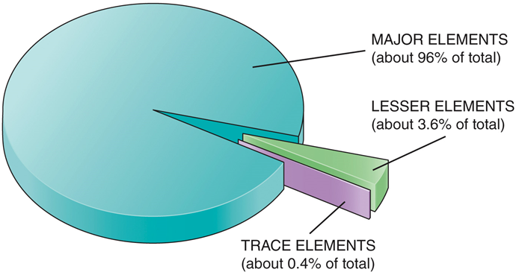
Main Chemical Elements in the Body
Chemical Element (Symbol) | % of Total Body Mass | Significance
Trace Elements | (about 0.4) | Aluminum (A l), boron (B), chromium (C r), cobalt (Co), copper (C u), fluorine (F), iodine (I), manganese (M n), molybdenum (M o), selenium (Se), silicon (S i), tin (S n), vanadium (V), and zinc (Zn).

Slide 12
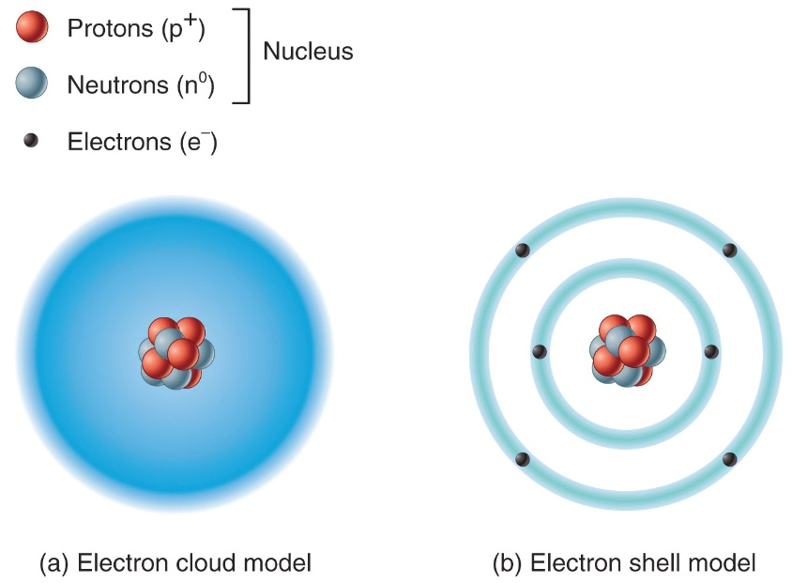
Atoms
Chemical elements are composed of units of matter of the same type called atoms
Atoms are the smallest units of matter that retain the properties and characteristics of an element

Slide 13
Atomic Structure
Central nucleus
Protons – positively charged
Neutrons – no charge
Electrons
Negatively charged
Orbit around nucleus

Slide 14
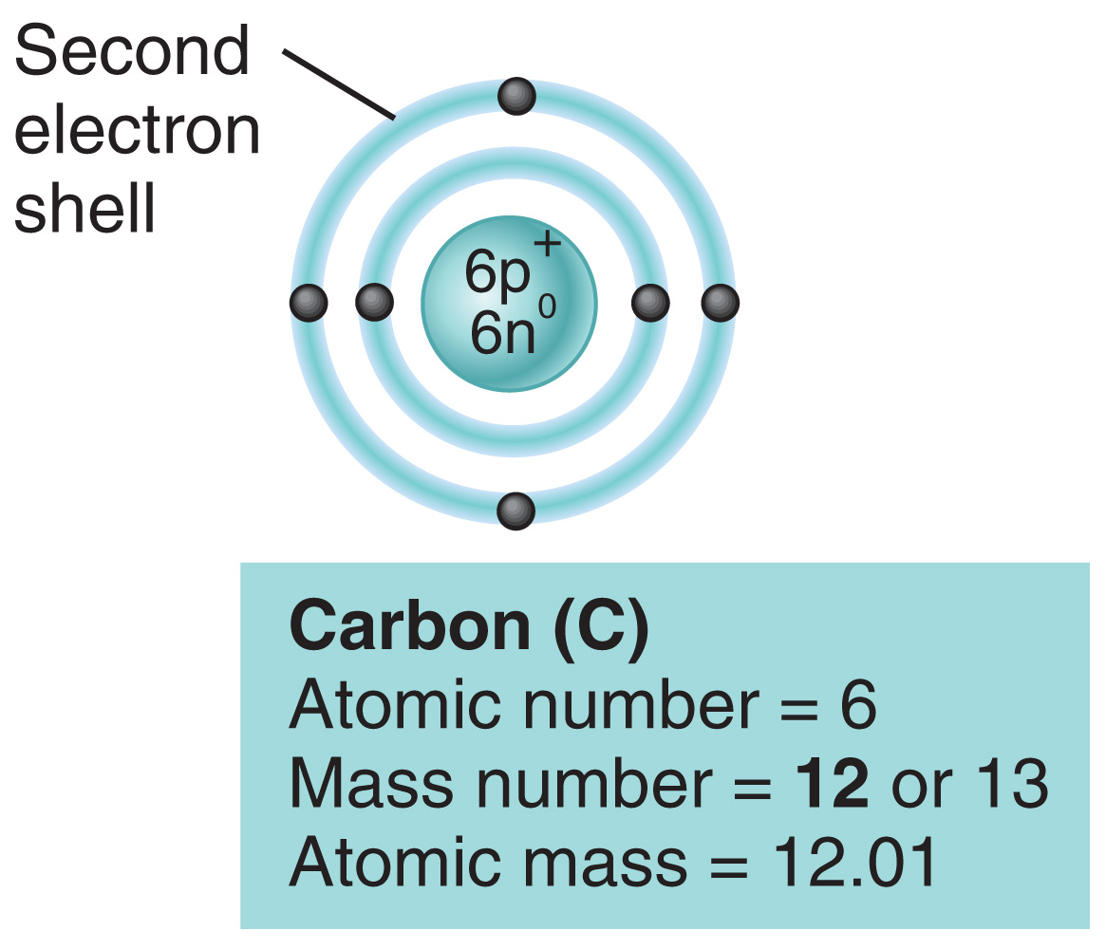
Atomic Number and Mass Number
Atomic number is the number of protons in the nucleus of an atom
Mass number is the number of protons and neutrons in an atom
Isotopes
Atoms that have the same atomic number but differ in their number of neutrons (have different atomic masses)

Slide 15
Radioactive Isotopes
Are unstable and break down/decay
Radioactive decay releases large amount of radiation energy
Depending on isotope, this radiation can be very damaging to cells
Decay is measured in half-lives
Amount of time it takes for ½ of the starting amount of the isotope to break down into a more stable form

Slide 16
Atomic Mass
Atomic mass assumes the mass of a:
Neutron = 1.008 daltons
Proton = 1.007 daltons
Electron = 0.0005 daltons
The atomic mass of an element is the average mass of all its naturally occurring isotopes

Slide 17
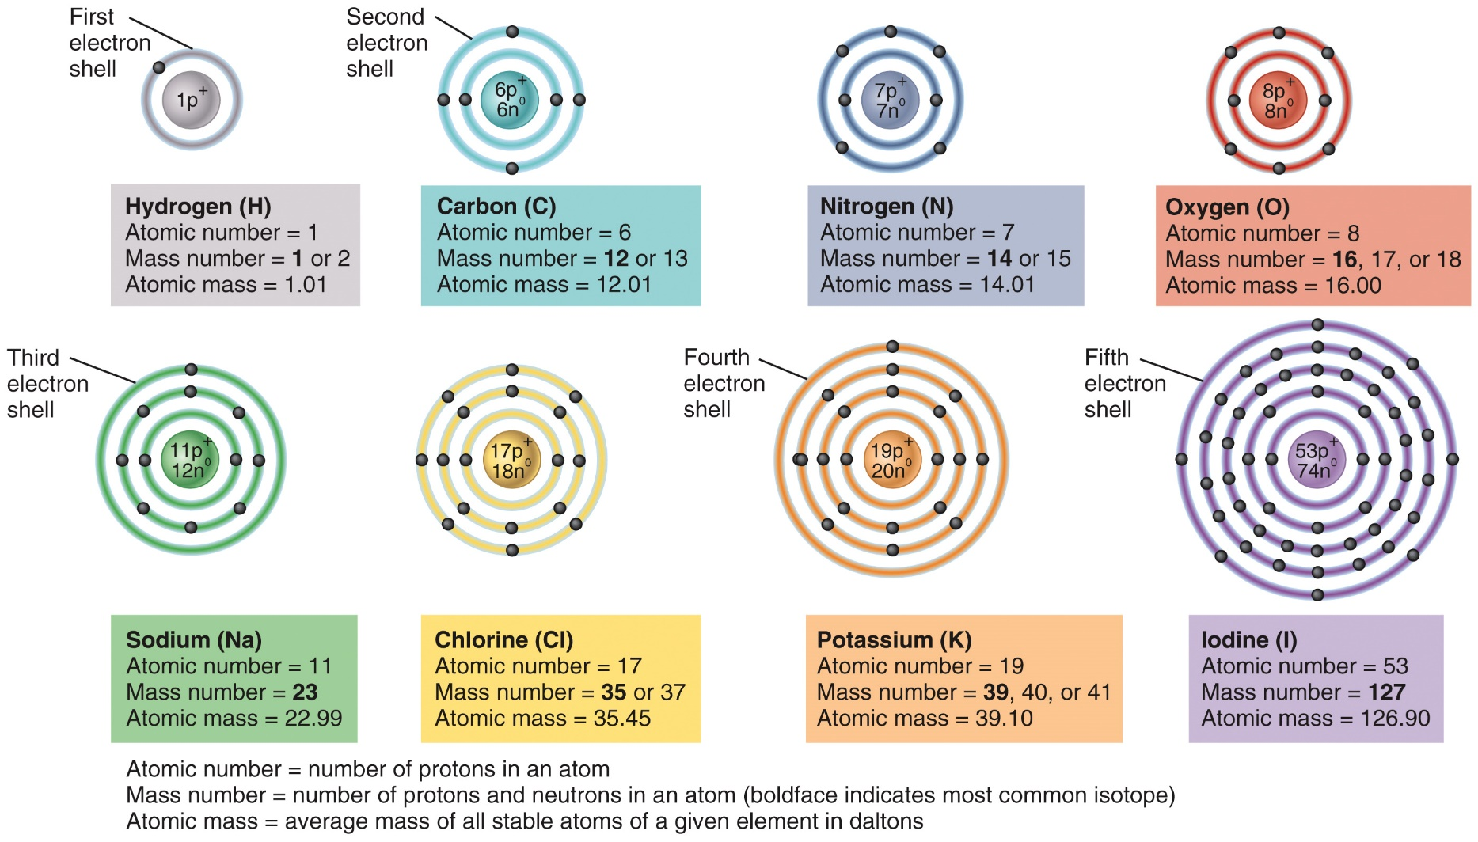
Atomic Structures

Slide 18
Ions, Molecules, and Compounds
Ion – an atom that has lost or gained an electron
Cation
Lost an electron
Positively charged
Anion
Gained an electron
Negatively charged
Molecule – 2 or more atoms sharing electrons
Compound – a substance that can be broken down into 2 or more different elements

Slide 19
Ions: Cations
Name | Symbol
Hydrogen ion | H⁺
Sodium ion | Na⁺
Potassium ion | K⁺
Ammonium ion | NH₄⁺
Magnesium ion | Mg²⁺
Calcium ion | Ca²⁺
Iron (II) ion | Fe²⁺
Iron (III) ion | Fe³⁺

Slide 20
Ions: Anions
Name | Symbol
Fluoride ion | F–
Chloride ion | Cl–
Iodide ion | I–
Hydroxide ion | OH–
Bicarbonate ion | HCO₃–
Oxide ion | O^{2–}
Sulfate ion | SO₄^{2–}
Phosphate ion | PO₄^{3–}

Slide 21
Orbitals, Shells, and Valence Electrons
Electron orbitals
Area around the nucleus where an electron is most likely to be found
Fits a maximum of two electrons
Energy shells
1st (closest to nucleus) is composed of one orbital
2nd and 3rd each composed to 4 orbitals
Valence electrons
Electrons in the outermost shell
Octet rule – goal is to obtain a full outer shell
Determines what type of bonds form
Nobel/inert gases – have full outer shells so they do not interact with other atoms

Slide 22
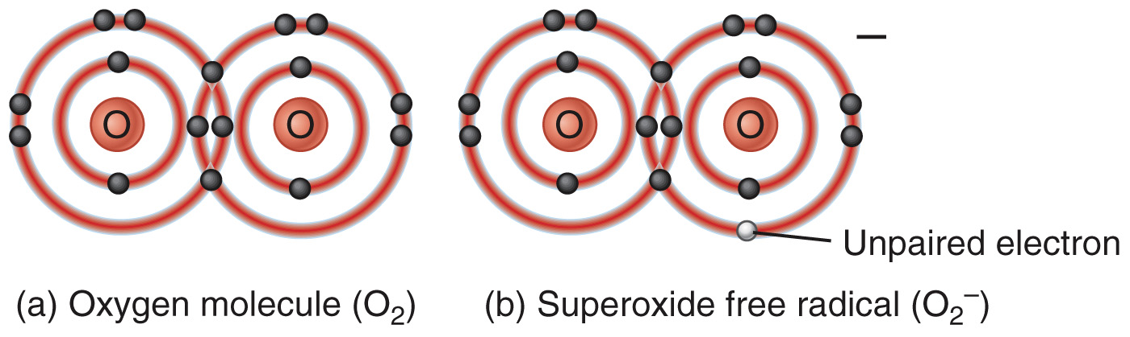
Free Radicals
Free Radicals have an unpaired electron in its outermost shell
Sources include UV rays from sunlight, ozone, x-rays, pollution, cigarette smoke
Antioxidants inactive oxygen-derived free radicals

Slide 23
Chemical Bonds

Slide 24
Chemical Bonding Interactions Animation:
Chemical Bonds

Slide 25
Chemical Bonds
A chemical bond occurs when atoms are held together by forces of attraction
The number of electrons in the valence shell determines the likelihood that an atom will form a chemical bond with another atom

Slide 26
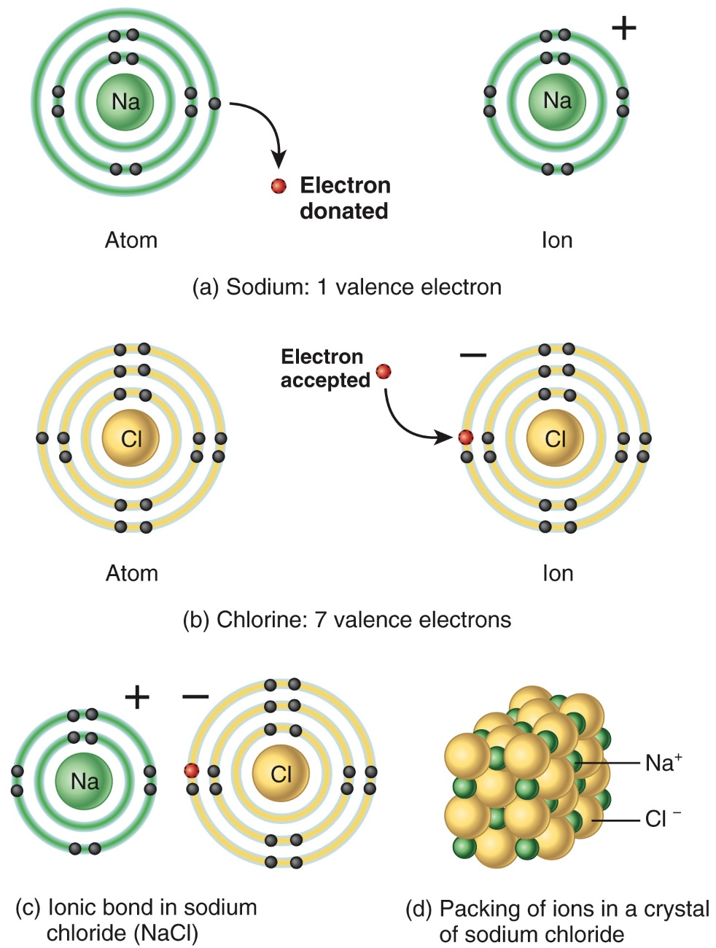
Ionic Bonds
Transfer of electrons
One atom donates an electron to become a positively charged cation
One atom accepts an electron to become a negatively charged anion
Opposite charges attract

Slide 27
Covalent Bonds
The sharing of electron pairs
Single bond
Shares one electron pair
Indicated by a single, horizontal line
Double bond
Shares two electron pairs
Indicated by two horizontal lines
Triple bond
Shares three electron pairs
Indicated by three horizontal lines

Slide 28
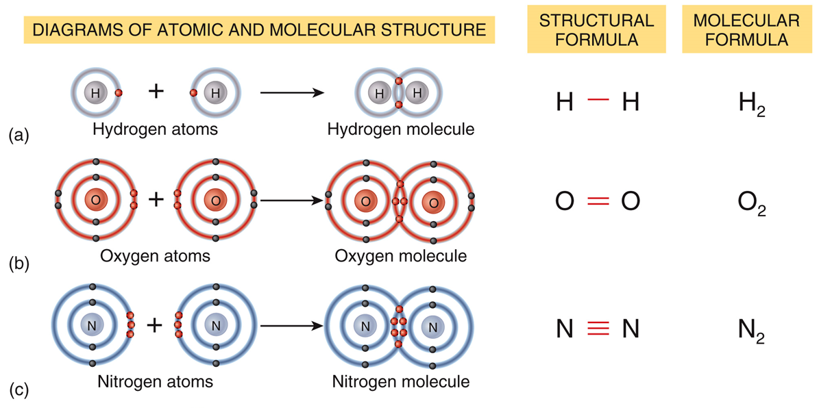
Covalent Bonds

Slide 29
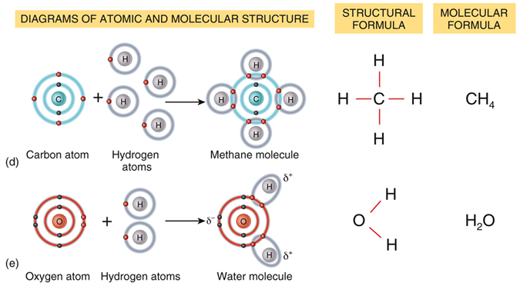
Covalent Bonds
Structural formula
Indicates specific bond arrangement
Molecular formula
Indicates number and type of each atom

Slide 30
Covalent Bonds
Polar
Unequal sharing of electrons
Molecule “side” with electrons is partially negative; “side” waiting for electrons is partially positive
Nonpolar
Equal sharing of electrons
No partial charges associated with nonpolar molecules

Slide 31
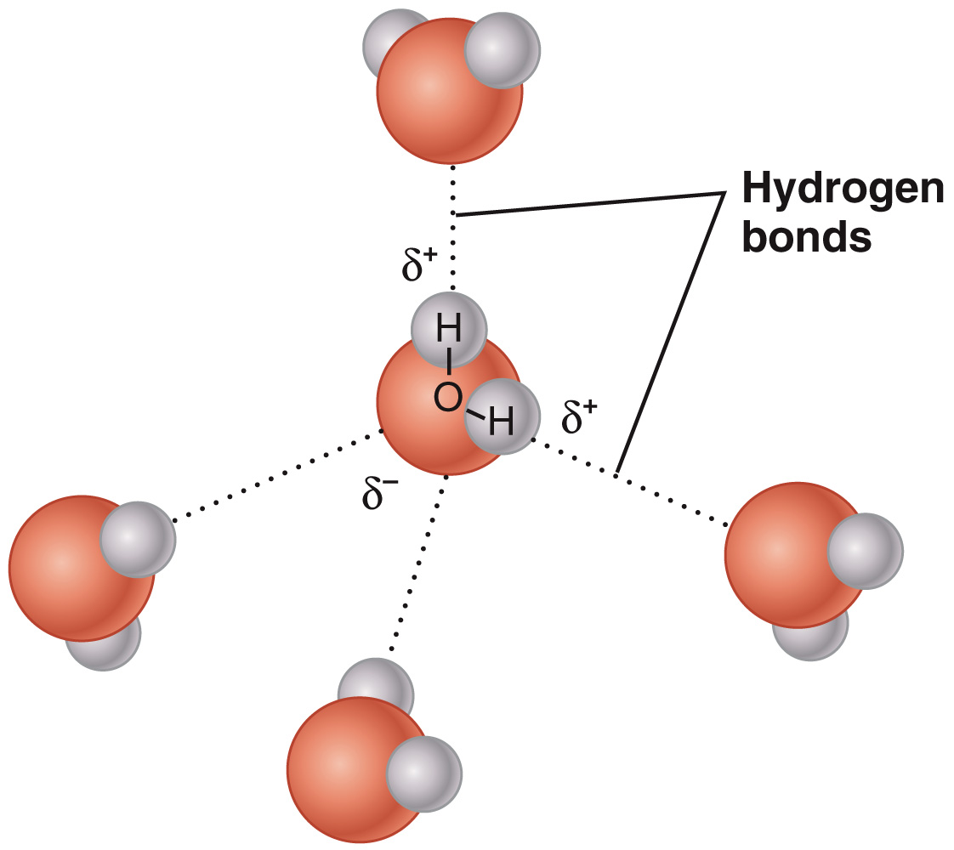
Hydrogen Bonds
Hydrogen bonds result from attraction of oppositely charged parts of molecules
Indicated as a dotted line, since the bonds constantly break and reform

Slide 32
Hydrogen Bonds and Water
Hydrogen bonds between water molecules give water cohesion
Cohesion is the tendency of like particles to stay together
Hydrogen bonds create surface tension
Surface tension is a measure of the difficulty of stretching or breaking the surface of a liquid

Slide 33
Chemical Reactions

Slide 34
Chemical Reactions
Chemical reactions occur when new bonds are formed or old bonds are broken
Reactants – starting substances
Products – ending substances
Metabolism – all reactions in a body
Catabolic reactions
Releases energy by breaking down larger molecules into smaller ones
Anabolic reactions
Requires energy to form larger molecules from smaller ones

Slide 35
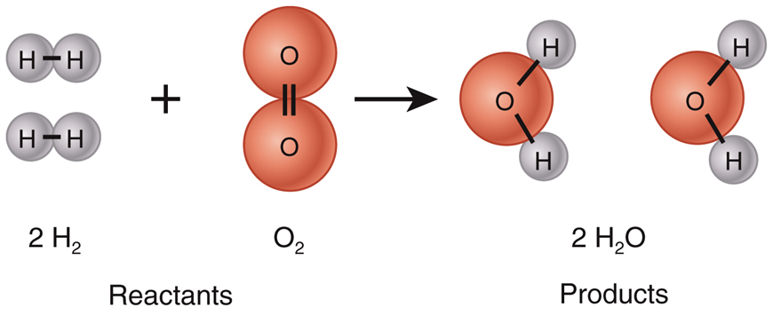
Chemical Reactions

Slide 36
Forms of Energy & Chemical Reactions
Energy is the capacity to do work
Potential energy
Kinetic energy
Chemical energy
Law of conservation of energy – energy can neither be created nor destroyed but it can be converted from one form to another

Slide 37
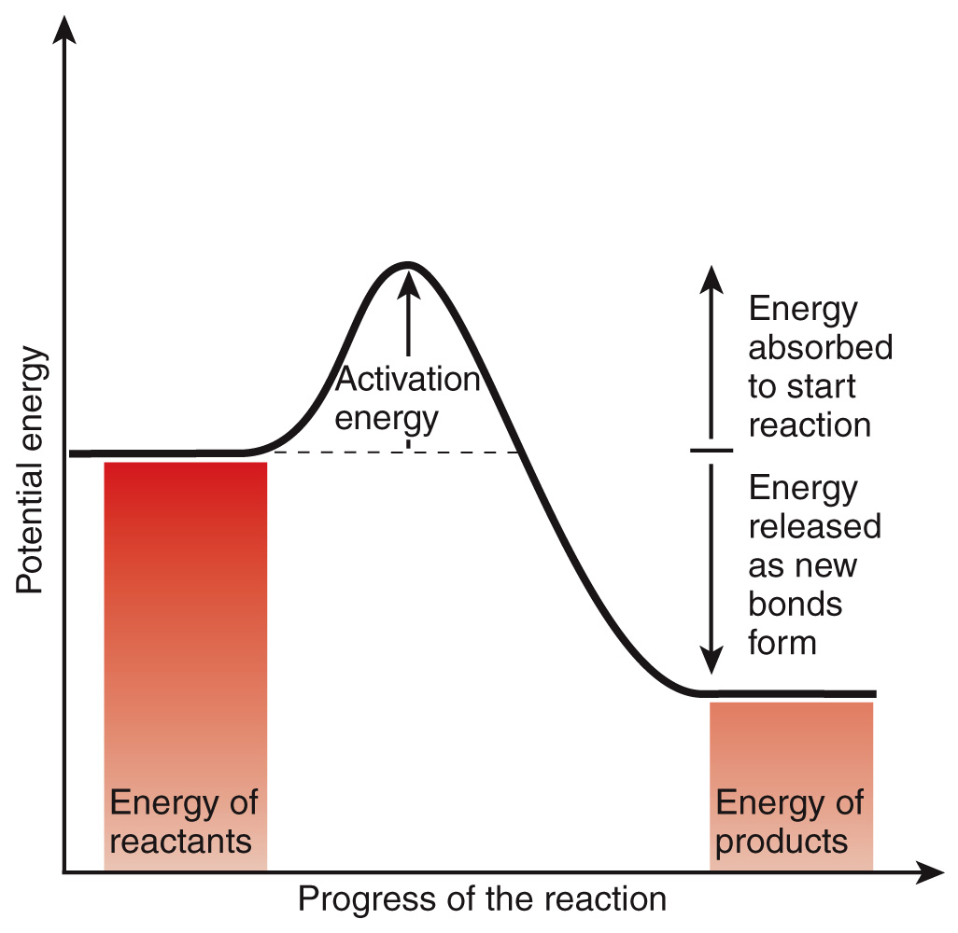
Energy Transfer
Exergonic reactions
Reactants have greater energy than products
Releases energy
Endergonic reactions
Products have greater energy than reactants
Requires energy
Activation energy
Energy required to initially start a chemical reaction

Slide 38
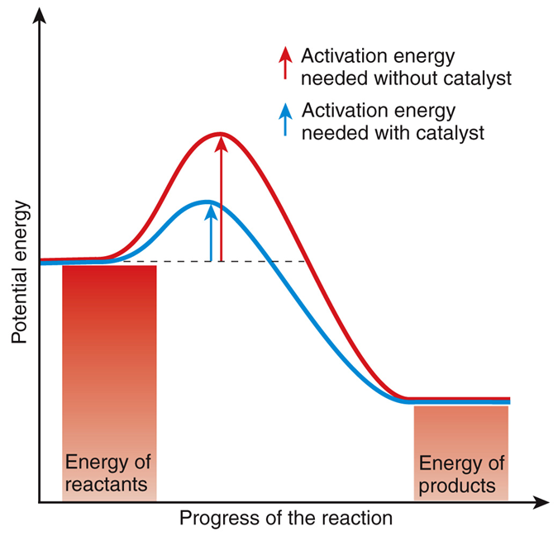
Catalysts
Lower activation energy requirements
Speeds up chemical reactions
Enzymes are biological catalysts

Slide 39
Types of Chemical Reactions

Slide 40
Types of Chemical Reactions
Synthesis
Decomposition
Exchange
Reversible
Oxidation-reduction

Slide 41
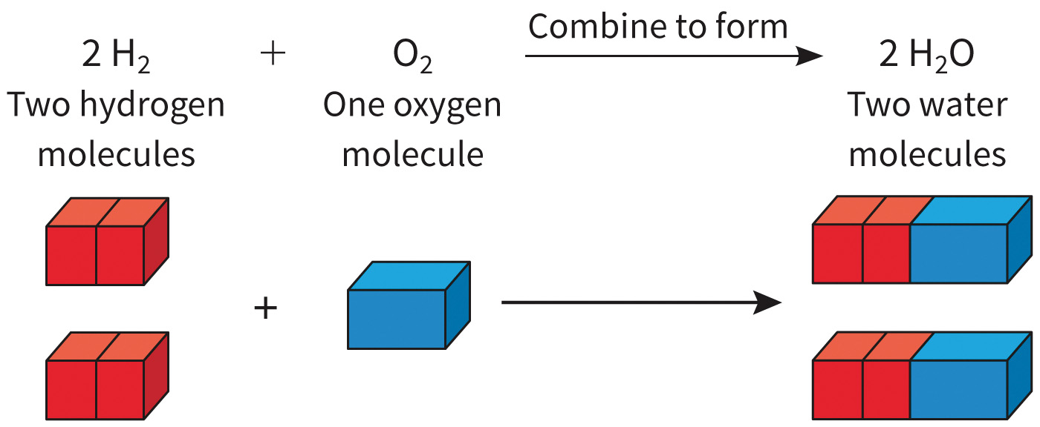
Synthesis Reactions - Anabolism
When two or more ions, atoms or molecules combine to form new and larger molecules

Slide 42
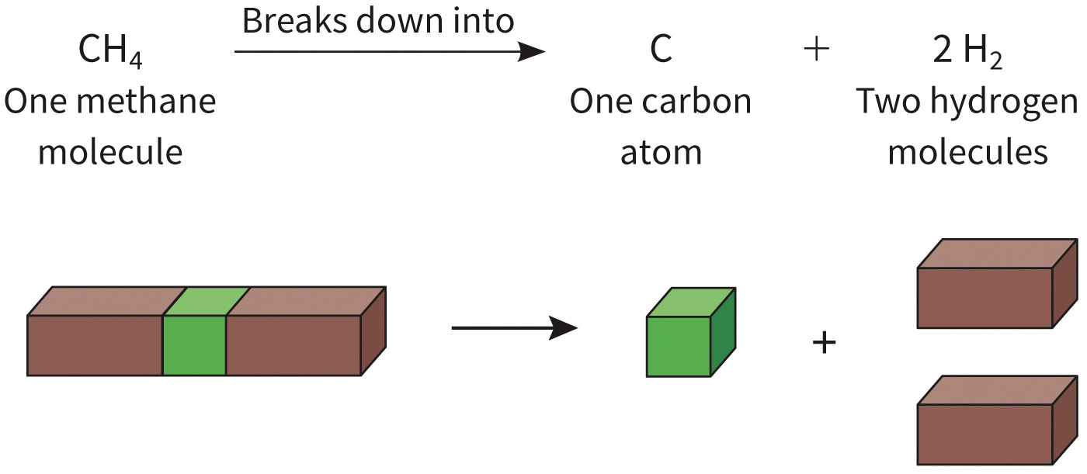
Decomposition Reactions - Catabolism
When large molecules are split into smaller atoms, ions, atoms or molecules

Slide 43
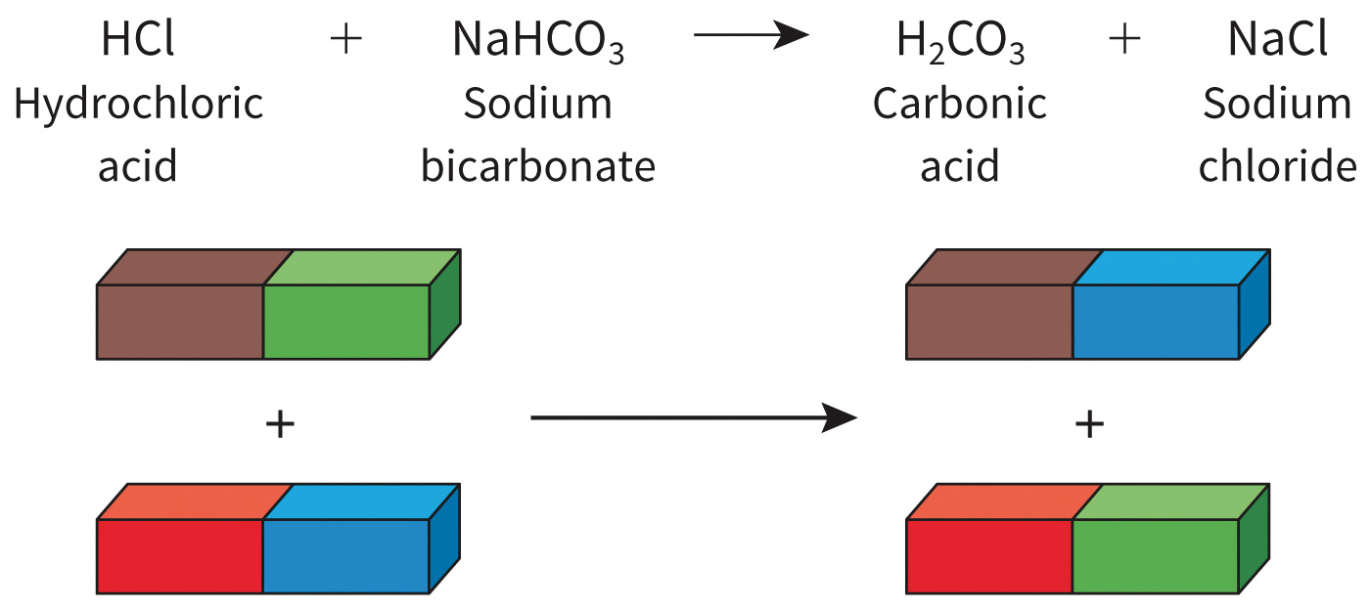
Exchange Reactions
Include both synthesis and decomposition reactions

Slide 44
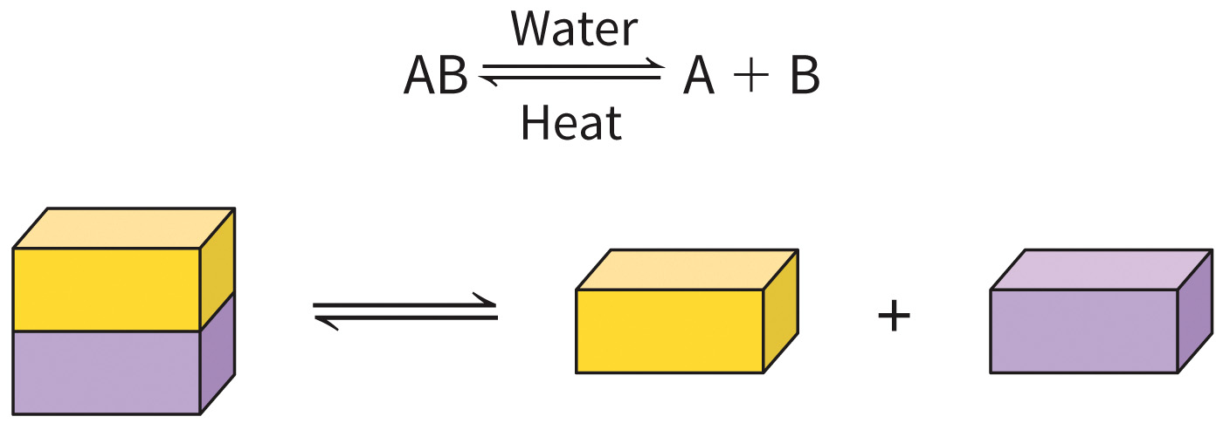
Reversible Reactions
Can proceed in either direction, as indicated by the double arrows.
Products can revert to original reactants

Slide 45
Oxidation-Reduction Reactions
These reactions transfer electrons between atoms and molecules and always occur in parallel (when one substance is oxidized another is reduced)
Oxidation – loss of electrons and energy release
Reduction – gain of electrons and energy gain
Reduced form of a molecule has greater energy than its oxidized form

Slide 46
Inorganic Compounds and Solutions

Slide 47
Inorganic vs. Organic Compounds
Inorganic compounds usually lack carbon and are simple molecules
Water is the most important and abundant inorganic compound in all living things
Organic compounds always contain C and H, usually contain O, and always have covalent bonds

Slide 48
Properties of Water Interactions Animation:
Polarity and Solubility of Molecules

Slide 49
Water as a Solvent
Solution
Solvent dissolves the solute (another substance)
Biology often includes aqueous (water-based) solutions
Since water is a polar molecule, it’s attracted to any other charged molecule or ion
Hydrophilic – “water loving”
Hydrophobic – “water-fearing”
Nonpolar molecules do not have a charge and are therefore not attracted to water

Slide 50
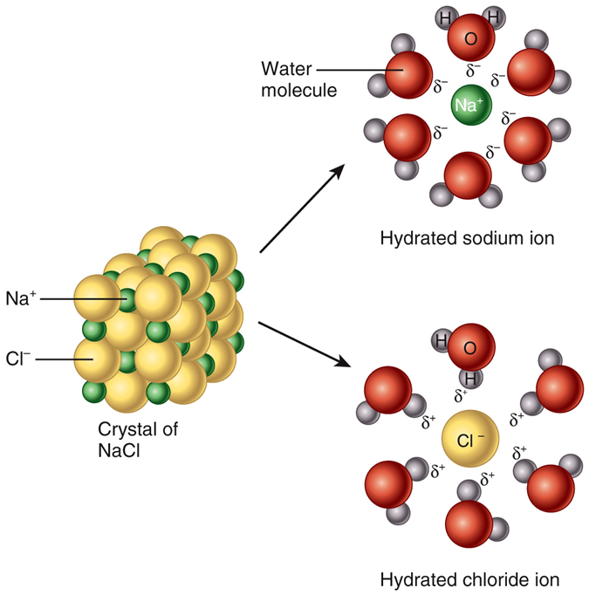
Water as a Solvent

Slide 51
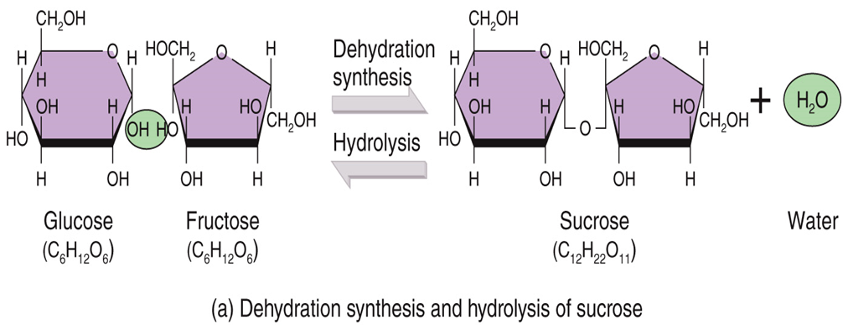
Water in Chemical Reactions
Water is the ideal medium
In a dehydration synthesis reaction, water is removed to make bonds
In a hydrolysis reaction, water is added to break bonds

Slide 52
Thermal Properties of Water
Water has a:
High heat capacity
Can absorb a large amount of energy without raising its temperature
Helps maintain human body temperature
High heat of vaporization
Water absorbs heat as it changes from a liquid to a gas
Evaporative cooling – when sweat, or other water, evaporates from your body, heat is removed and cools you down

Slide 53
Water as a Lubricant
Water is a major component of our body fluids and helps reduce friction as membranes and organs slide over one another

Slide 54
Mixtures
Mixture – a combination of elements or compounds that are physically blended together but not bonded together
3 types of mixtures:
Solution
Once mixed together, the solutes are evenly dispersed among the solvent molecules
Colloid
Solute particles are large enough to scatter light
Suspension
Solute particles can settle out of suspending liquid

Slide 55
Percentage & Molarity
Definition | Example
Percentage (mass per volume) Number of grams of a substance per 100 milliliters (mL) of solution | To make a 10% NaCl solution, take 10 g of NaCl and add enough water to make a total of 100 mL of solution.
Molarity—(moles per liter) A 1 molar (1 M) solution = 1 mole of a solute in 1 liter of solution | To make a 1 molar (1 M) solution of NaCl, dissolve 1 mole of NaCl (58.44 g) in enough water to make a total of 1 liter of solution.

Slide 56
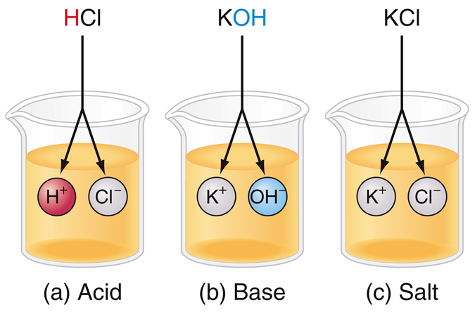
Acids, Bases, & Salts
All dissociate in water; dissociation is separation/break down ions
Acids – contributes H+
Bases – contributes OH-
Salts – contributes neither H+ nor OH-

Slide 57
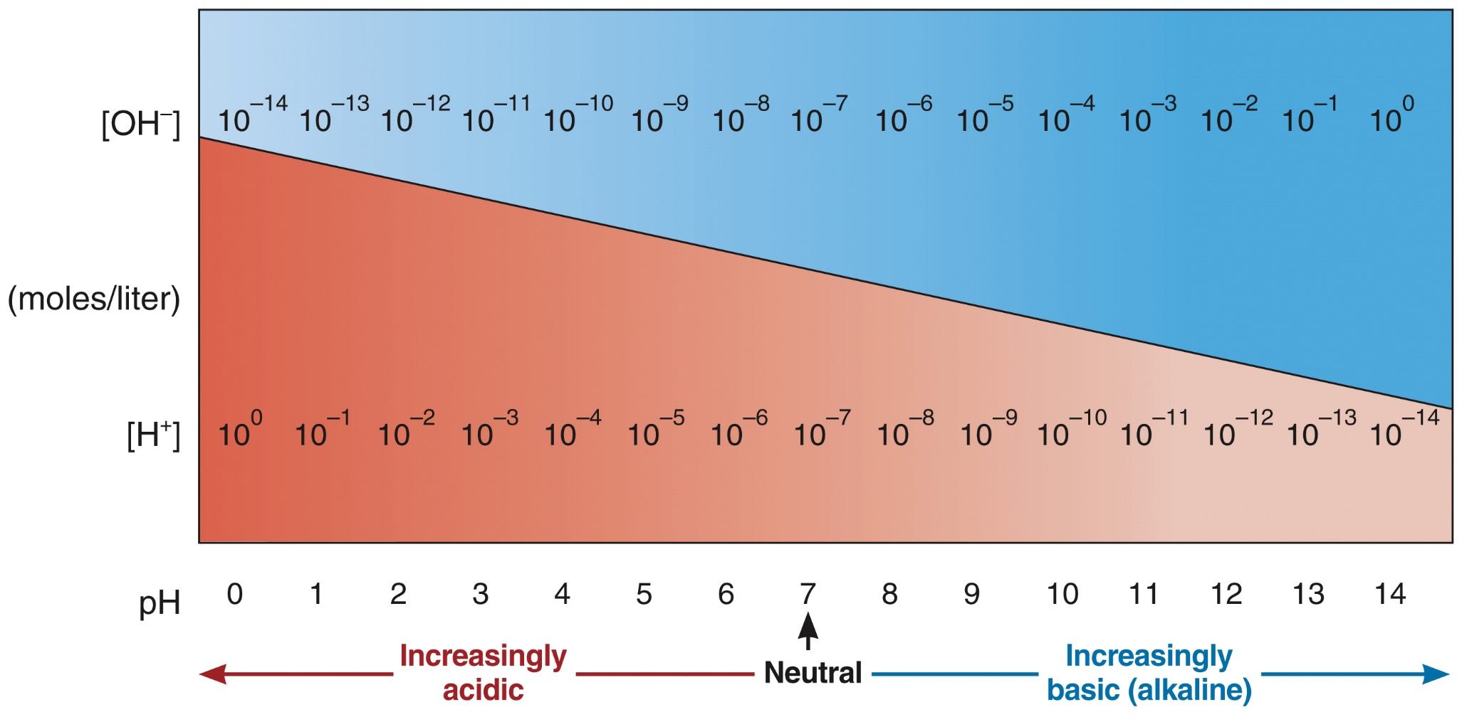
pH

Slide 58
pH
pH Values of Selected Substances (asterisks indicate substances in the human body)
Substance | pH Value
* Gastric juice (found in the stomach) | 1.2–3.0
Lemon juice | 2.3
Vinegar | 3.0
Carbonated soft drink | 3.0–3.5
Orange juice | 3.5
* Vaginal fluid | 3.4–4.5
Tomato juice | 4.2
Coffee | 5.0
* Urine | 4.6–8.0
* Saliva | 6.35–6.85

Slide 59
pH
pH Values of Selected Substances (asterisks indicate substances in the human body)
Substance | pH Value
Milk | 6.8
Distilled (pure) water | 7.0
* Blood | 7.35–7.45
* Semen (fluid containing sperm) | 7.20–7.60
* Cerebrospinal fluid (fluid associated with nervous system) | 7.4
* Pancreatic juice (digestive juice of the pancreas) | 7.1–8.2
* Bile (liver secretion that aids fat digestion) | 7.6–8.6
Milk of magnesia | 10.5
Lye (sodium hydroxide) | 14.0

Slide 60
pH and Buffers Interactions Animation:
Acids and Bases

Slide 61
Buffer Systems
Maintenance of body fluid homeostasis is critical
H⁺ + HCO₃⁻ ↔ H₂CO₃
hydrogen ion biarcarbonate ion carbonic acid
_{(weak base)}
If blood pH drops too low, bicarbonate ion will remove excess hydrogen ions from solution, resulting in a rise of pH
If blood pH becomes too high, carbonic acid will dissociate to release hydrogen ions, resulting in a drop in pH

Slide 62
Overview of Organic Compounds

Slide 63
Carbon
Organic compounds always contain carbon
Carbons can combine in a variety of shapes
Carbon has 4 valence electrons, so needs to form 4 covalent bonds in order to complete its outer shell
Carbon compounds do not dissolve easily in water
Carbon compounds are a good source of energy

Slide 64
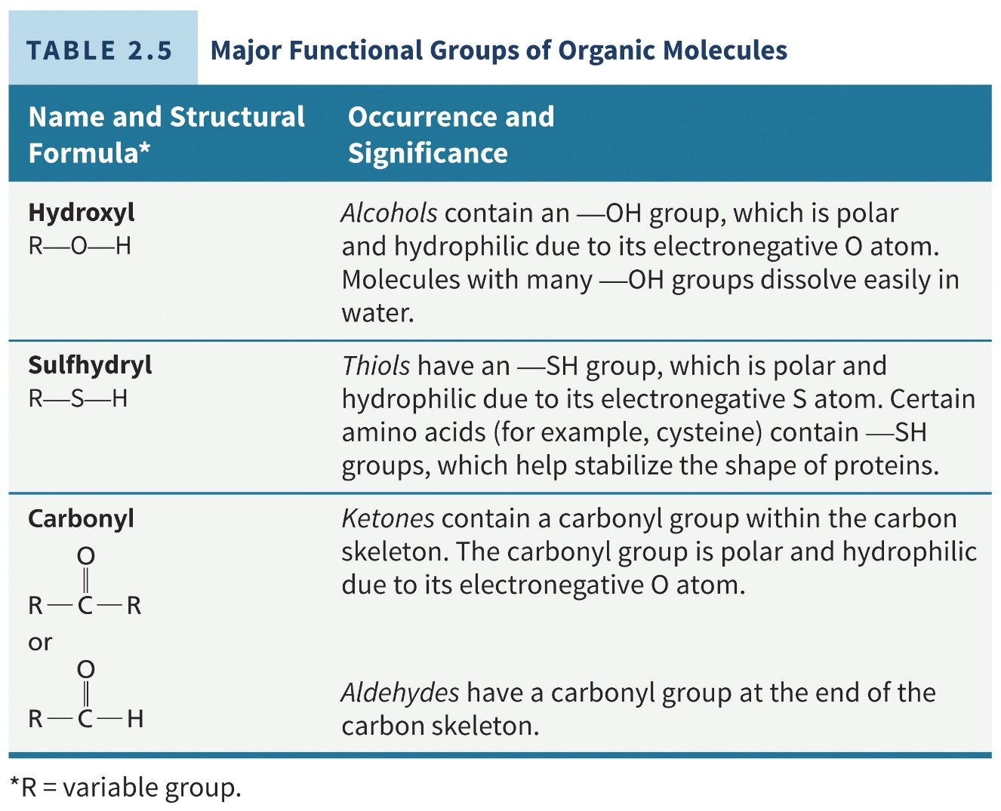
Major Functional Groups of Organic Compounds

Slide 65
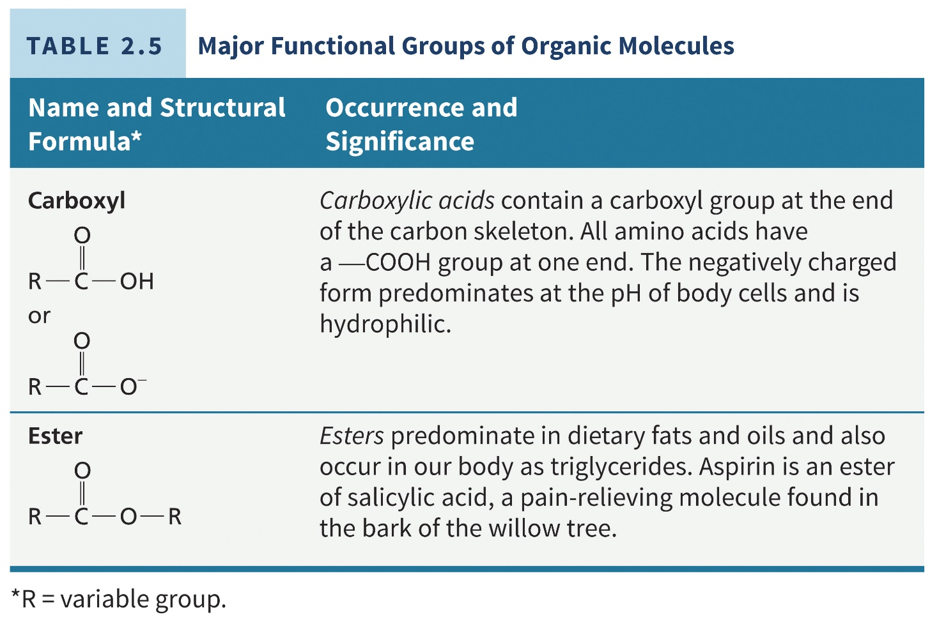
Major Functional Groups of Organic Compounds

Slide 66
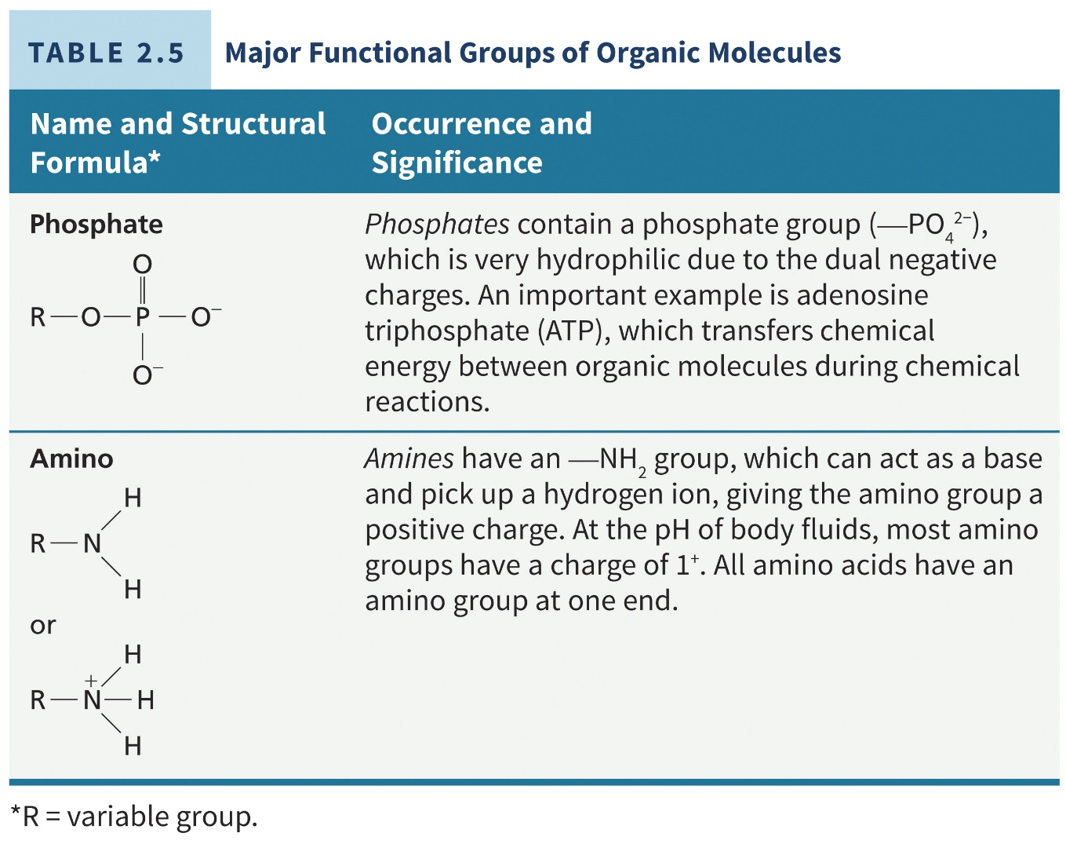
Major Functional Groups of Organic Compounds

Slide 67
Macromolecules
Carbohydrates
Lipids
Proteins
Nucleic acids

Slide 68
Carbohydrates
Comprised of carbon, hydrogen and oxygen
Include sugars, glycogen, starches and cellulose
Main source of chemical energy
2-3% of total body mass

Slide 69
Major Carbohydrate Groups
Type of Carbohydrate | Examples
Monosaccharides (simple sugars that contain from 3 to 7 carbon atoms) | Glucose (the main blood sugar). Fructose (found in fruits). Galactose (in milk sugar). Deoxyribose (in DNA). Ribose (in RNA).
Disaccharides (simple sugars formed from the combination of two monosaccharides by dehydration synthesis) | Sucrose (table sugar) = glucose + fructose. Lactose (milk sugar) = glucose + galactose. Maltose = glucose + glucose.

Slide 70
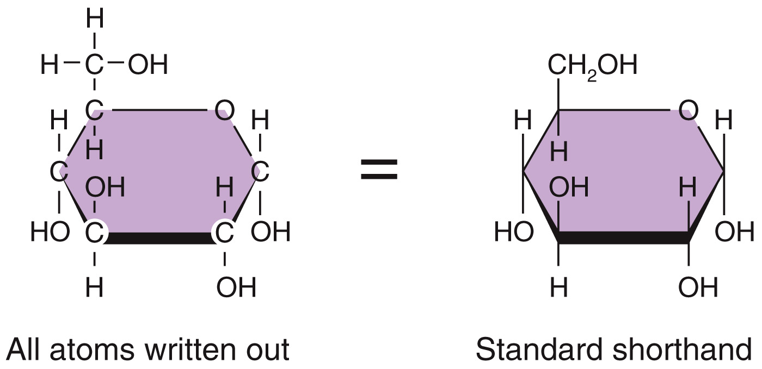
Glucose

Slide 71
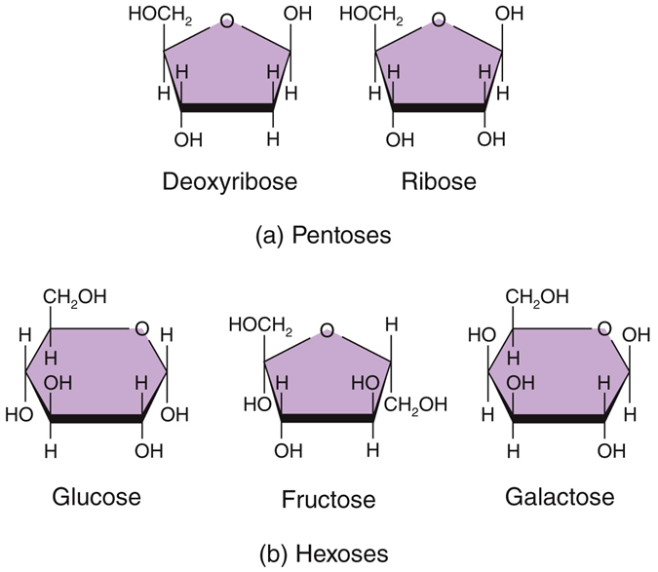
Monosaccharides
Ratio of 1:2:1 of carbon:hydrogen:oxygen
Isomers – have same molecular formula but vary in structural formula
Pentoses
5-carbon sugars
Often used as a component of DNA and RNA
Hexoses
6-carbon sugars
Often used for energy

Slide 72
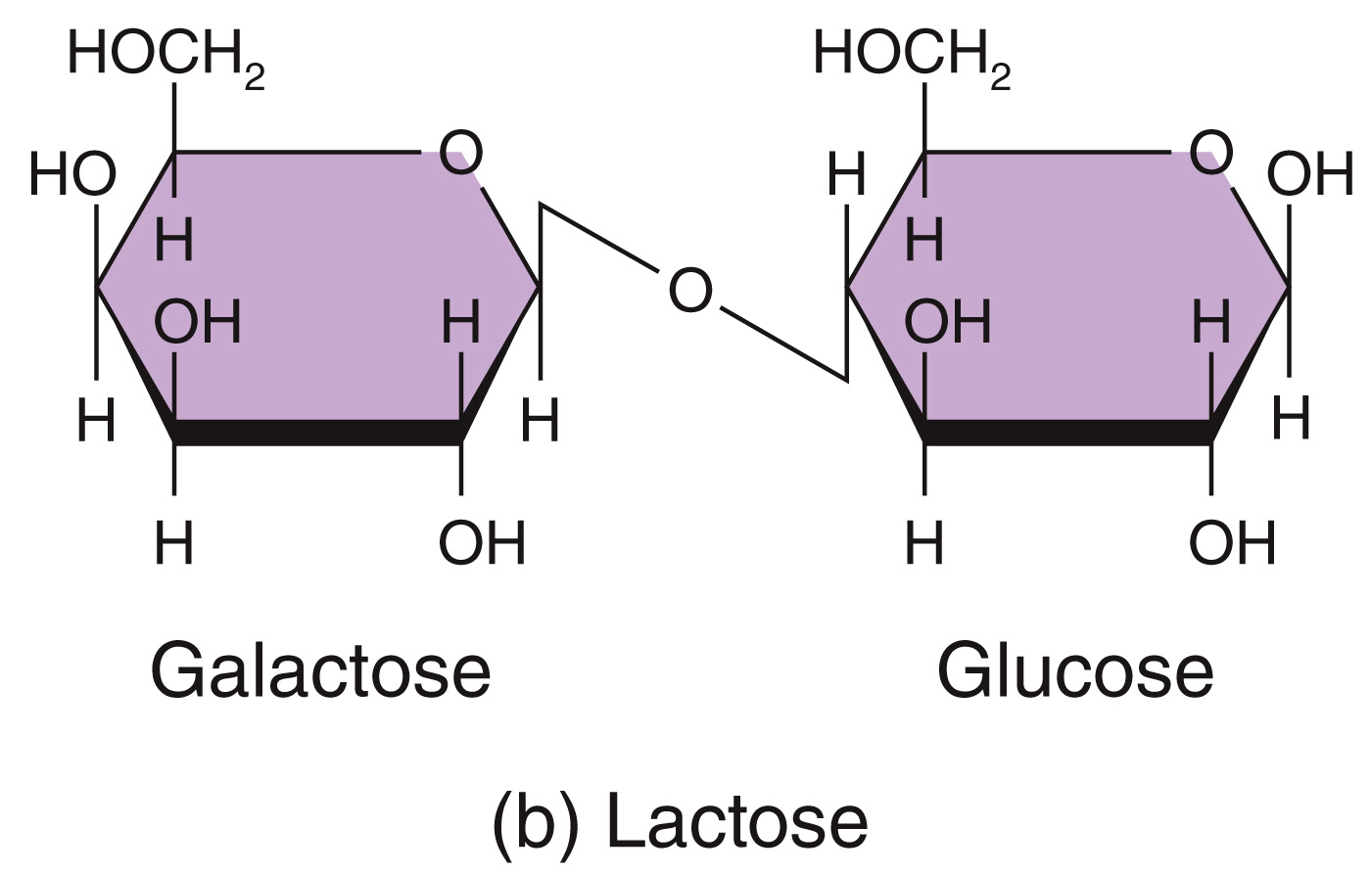
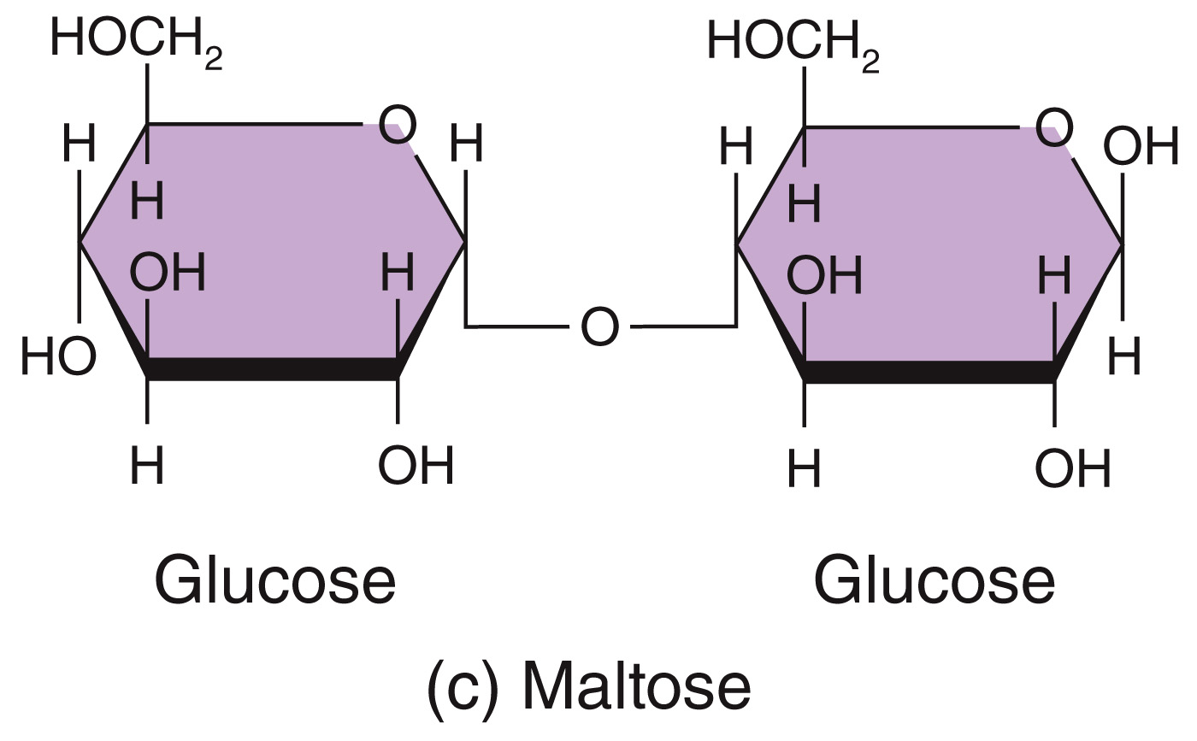
Disaccharides
2 monosaccharides joined by dehydration synthesis
Both monosaccharide and disaccharide names tend to end with “-ose”

Slide 73
Major Carbohydrate Groups
Type of Carbohydrate | Examples
Polysaccharides (from tens to hundreds of monosaccharides joined by dehydration synthesis) | Glycogen (stored form of carbohydrates in animals). Starch (stored form of carbohydrates in plants and main carbohydrates in food). Cellulose (part of cell walls in plants that cannot be digested by humans but aids movement of food through intestines).

Slide 74
Carbohydrates
Polysaccharides/complex carbohydrates
Storage carbohydrates
Glycogen – stored in liver and muscle
Will hydrolyze into its glucose subunits in response to drop in blood sugar
Starch – plant equivalent to glycogen
Structural carbohydrates
Cellulose – part of plant cell walls; cannot be digested by humans but aids with movement of GI tract contents

Slide 75
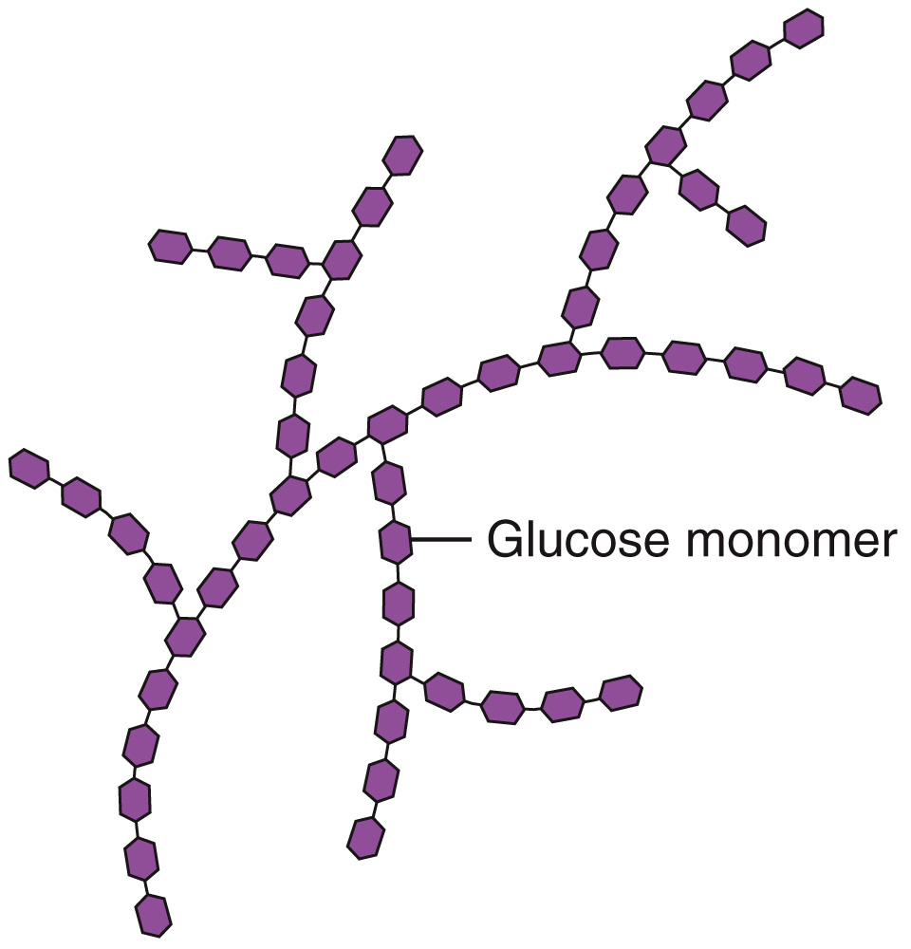
Polysaccharides

Slide 76
Types of Lipids in the Body
Type of Lipid | Functions
Fatty acids | Used to synthesize triglycerides and phospholipids or catabolized to generate adenosine triphosphate (ATP).
Triglycerides (fats and oils) | Protection, insulation, energy storage.
Phospholipids | Major lipid component of cell membranes.

Slide 77
Types of Lipids in the Body
Type of Lipid | Functions
Steroids: Cholesterol | Minor component of all animal cell membranes; precursor of bile salts, vitamin D, and steroid hormones.
Steroids: Bile salts | Needed for digestion and absorption of dietary lipids.
Steroids: Vitamin D | Helps regulate calcium level in body; needed for bone growth and repair.
Steroids: Adrenocortical hormones | Help regulate metabolism, resistance to stress, and salt and water balance.
Steroids: Sex hormones | Stimulate reproductive functions and sexual characteristics.

Slide 78
Types of Lipids in the Body
Type of Lipid | Functions
Eicosanoids (prostaglandins and leukotrienes) | Have diverse effects on modifying responses to hormones, blood clotting, inflammation, immunity, stomach acid secretion, airway diameter, lipid breakdown, and smooth muscle contraction.
Other lipids: Carotenes | Needed for synthesis of vitamin A (used to make visual pigments in eye); function as antioxidants.
Other lipids: Vitamin E | Promotes wound healing, prevents tissue scarring, contributes to normal structure and function of nervous system, and functions as antioxidant.
Other lipids: Vitamin K | Required for synthesis of blood-clotting proteins.
Other lipids: Lipoproteins | Transport lipids in blood, carry triglycerides and cholesterol to tissues, and remove excess cholesterol from blood.

Slide 79
Fatty Acids
Fatty acids can be saturated or unsaturated
Saturated fatty acids (no double bonds)
Linear
Solid at room temperature
Unsaturated fatty acids
Bends at double-bond location
Liquid at room temperature

Slide 80
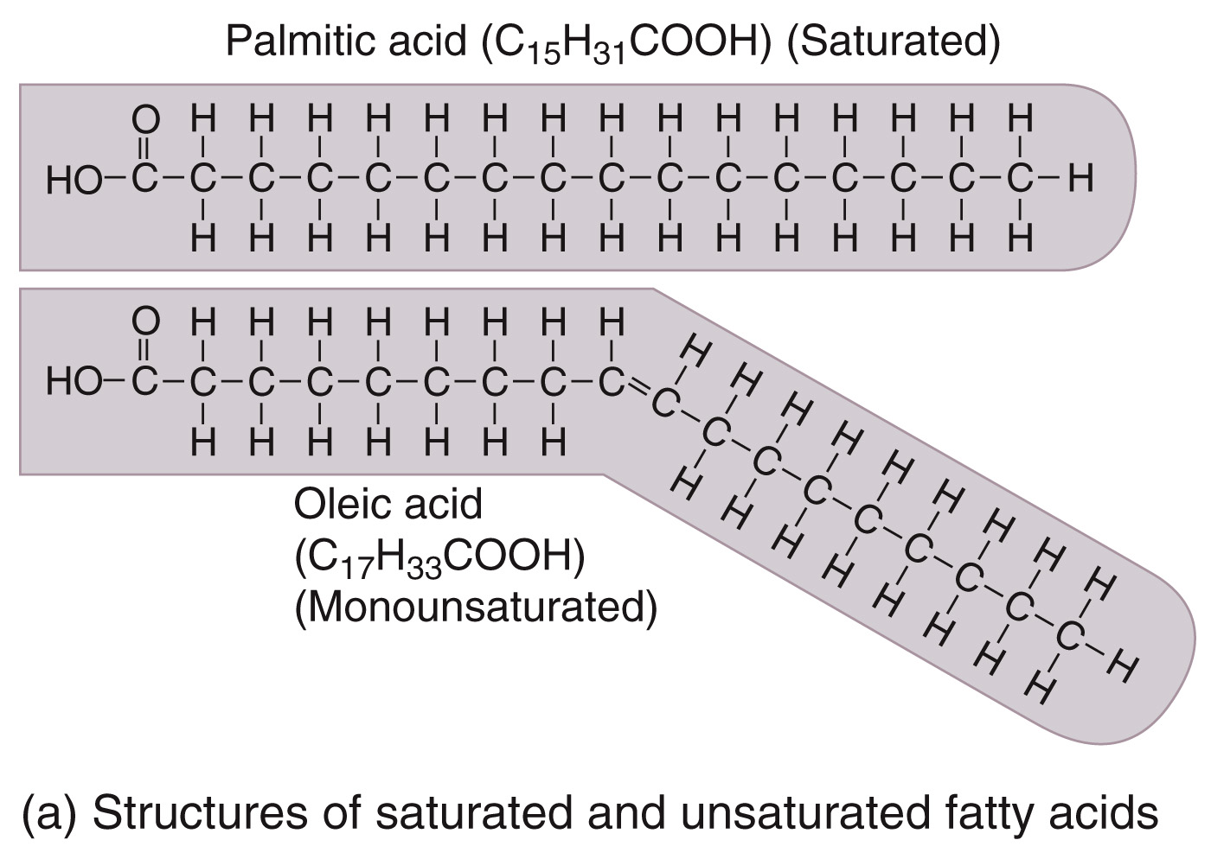
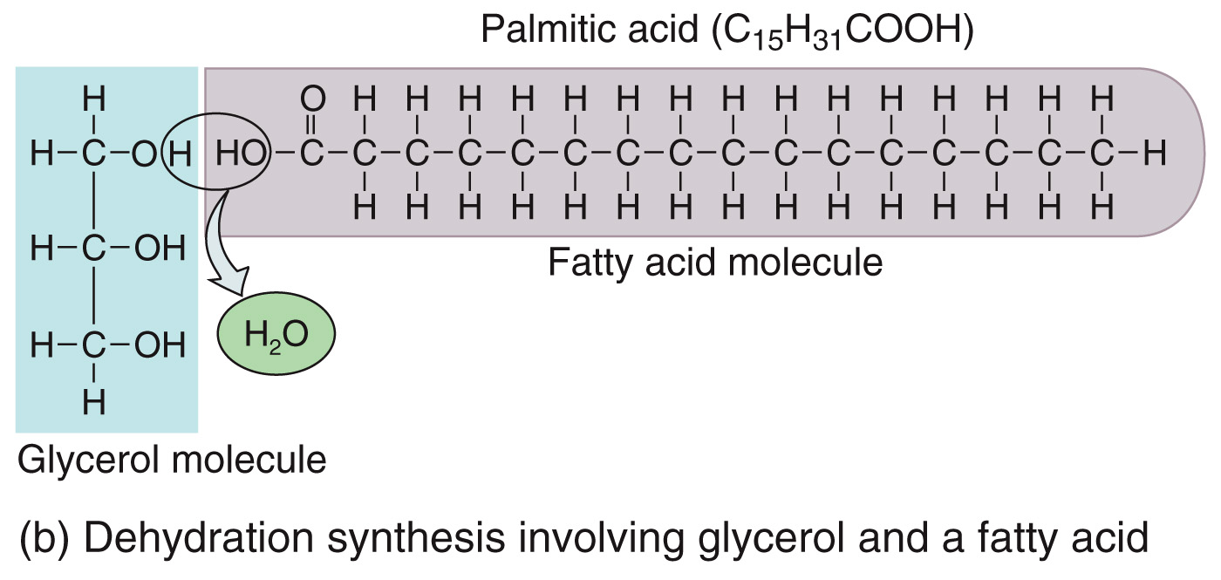
Fatty Acids

Slide 81
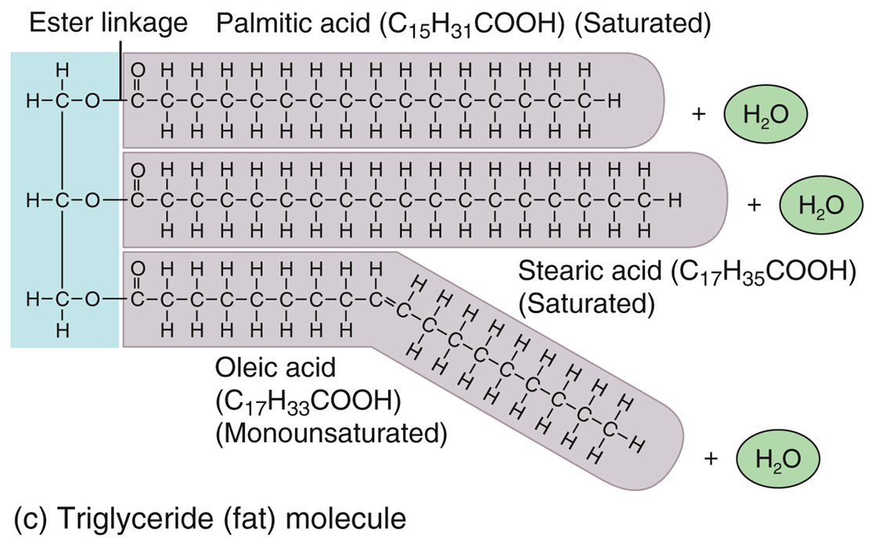
Triglycerides
Also known as fats
Glycerol with 3 fatty acid chains
Triglycerides provide protection, insulation, and energy

Slide 82
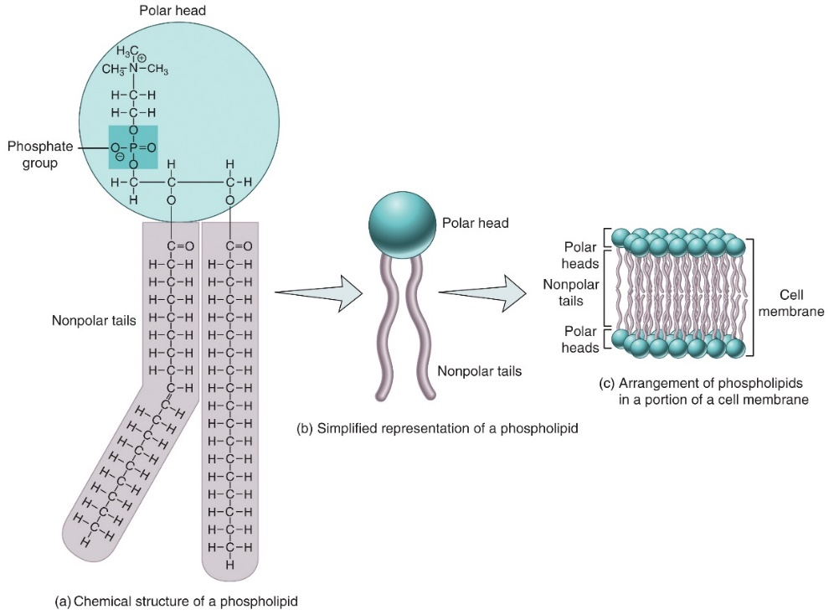
Phospholipids
Phospholipids are an important component of cell membranes
Glycerol, phosphate, with two fatty acid tails
Hydrophilic heads; hydrophobic tails
Forms micelles (droplets) or bilayers in effort to isolate tails from water-based/aqueous solutions

Slide 83
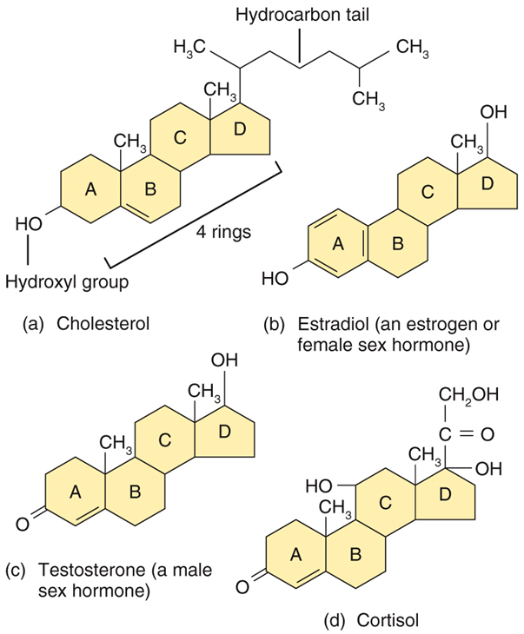
Steroids
4 fused rings with various groups attached
Cholesterol is the precursor to sex hormones
Cholesterol is also component of plasma membrane

Slide 84
Proteins
Proteins give structure to the body, regulate processes, provide protection, assist in muscle contraction, transport substances, and serve as enzymes

Slide 85
Functions of Proteins
Type of Protein | Functions
Structural | Form structural framework of various parts of body. Examples: collagen in bone and other connective tissues; keratin in skin, hair, and fingernails.
Regulatory | Function as hormones that regulate various physiological processes; control growth and development; as neurotransmitters, mediate responses of nervous system. Examples: the hormone insulin (regulates blood glucose level); the neurotransmitter known as substance P (mediates sensation of pain in nervous system).
Contractile | Allow shortening of muscle fibers (cells) which produces movement. Examples: myosin; actin.

Slide 86
Functions of Proteins
Type of Protein | Functions
Immunological | Aid responses that protect body against foreign substances and invading pathogens. Examples: antibodies; interleukins.
Transport | Carry vital substances throughout body. Example: hemoglobin (transports most oxygen and some carbon dioxide in blood).
Catalytic | Act as enzymes that regulate biochemical reactions. Examples: salivary amylase; sucrase; ATPase.

Slide 87
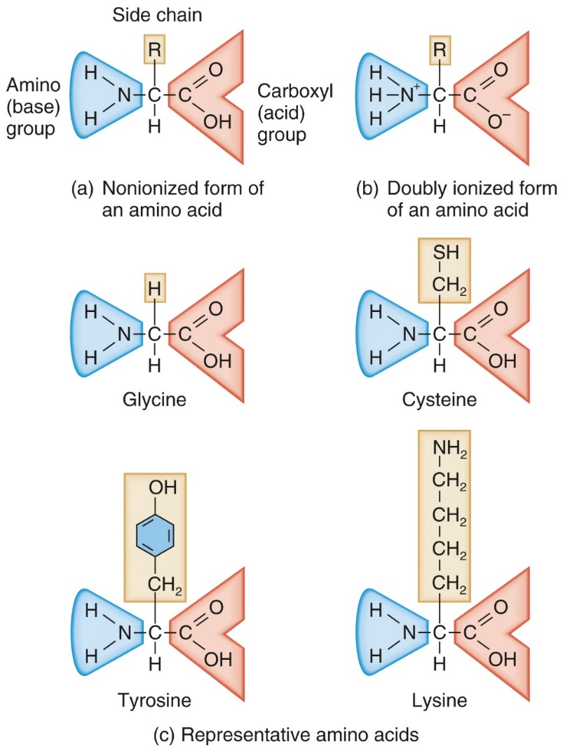
Amino Acids
Monomer of proteins
Structure
Central carbon atom forms 4 bonds with:
Amino group
Carboxyl group
H atom
R group
What is at the variable R region defines the specific amino acid and its chemical properties

Slide 88
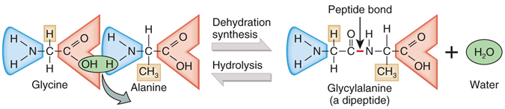
Peptide Bond Formation
Amino acids are linked together via dehydration synthesis
Peptide bond
Polypeptide – chain of dozens to hundreds of amino acids linked together

Slide 89
Protein Structure
Primary structure
Sequence of amino acids in the chain
Secondary structure
Formed by hydrogen bonds
Alpha helix or beta pleated sheath
Tertiary structure
Interaction of R groups
Quaternary structure
If a protein is composed of more than one polypeptide chain, how the chains join together

Slide 90
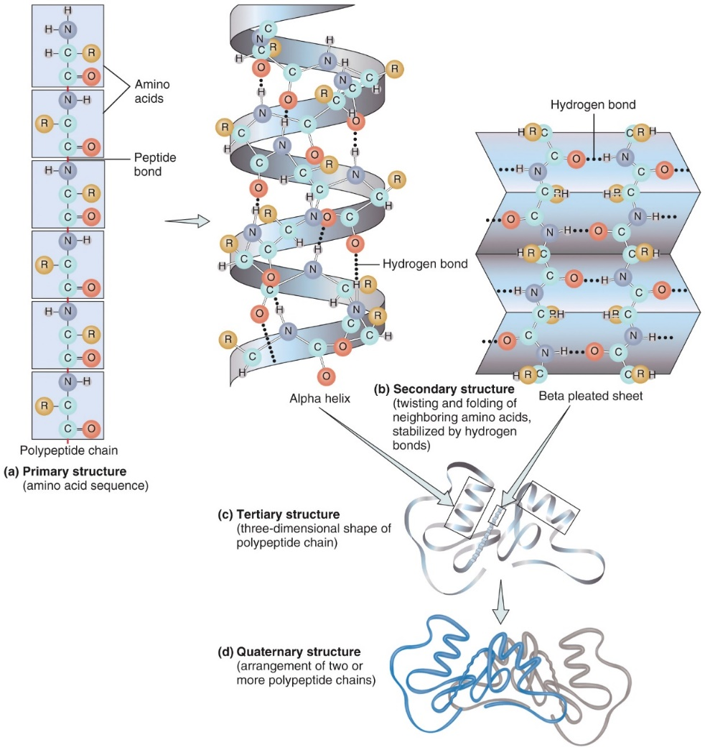
Structural Organization in Proteins

Slide 91
Proteins - Enzymes
Active site – pocket/cleft where the substrate (reactant) fits
Induced fit
Once the substrate binds to active site, the enzyme shape alters slightly
An enzyme is a catalyst in a living cell
Enzymes are:
Highly specific
Extremely efficient
Subject to cellular controls

Slide 92
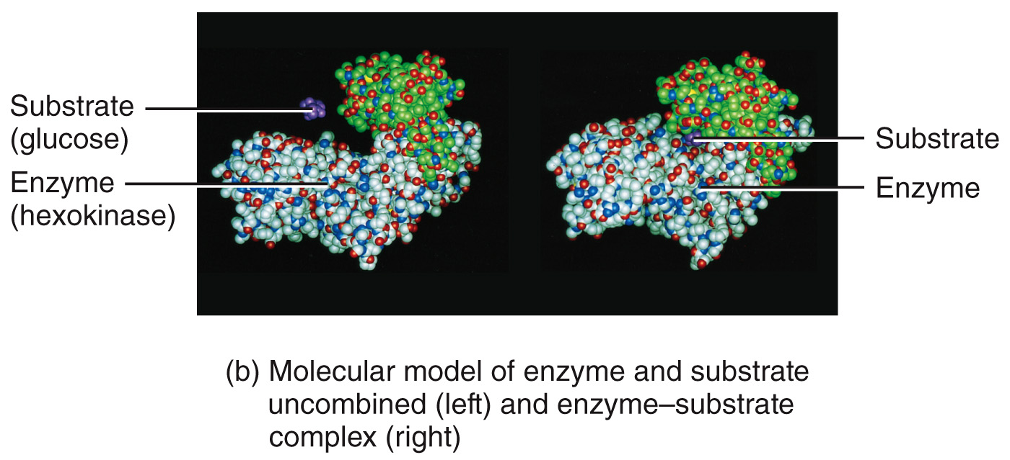
Enzyme-Substrate Complexes

Slide 93
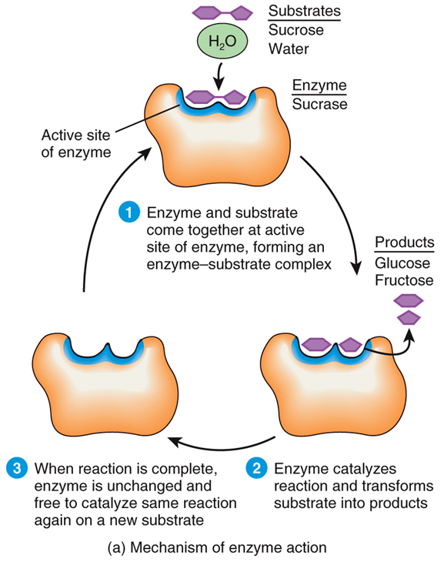
Enzymes
Names tend to end in “-ase”
Often named by their substrate (example: sucrase {sucrose is substrate}) or their action (example: dehydrogenase – removes hydrogen)
Are not altered; can be reused

Slide 94
Enzymes Interactions Animation:
Enzyme Functions and ATP

Slide 95
Nucleic Acids
DNA – deoxyribonucleic acid
Forms the genetic code and regulates most of the cell’s activities
RNA – ribonucleic acid
Guides protein formation

Slide 96
Nucleotide
Monomer of nucleic acids
Structure
Pentose sugar
Deoxyribose in DNA; ribose in RNA
Phosphate group
Nitrogenous base
Adenine
Guanine
Cytosine
Thymine (only in DNA)
Uracil (only in RNA)

Slide 97
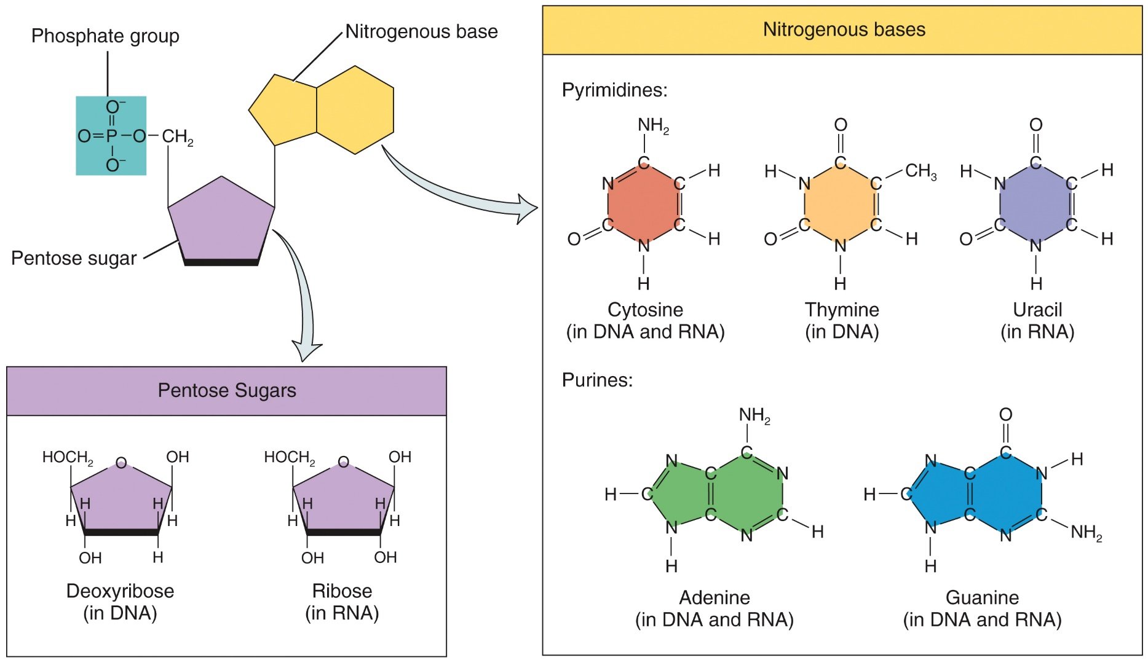
Components of a Nucleotide

Slide 98
Nucleic Acids
DNA is double-stranded
Adenine hydrogen bonds with thymine
Guanine hydrogen bonds with cytosine
RNA is single-stranded

Slide 99
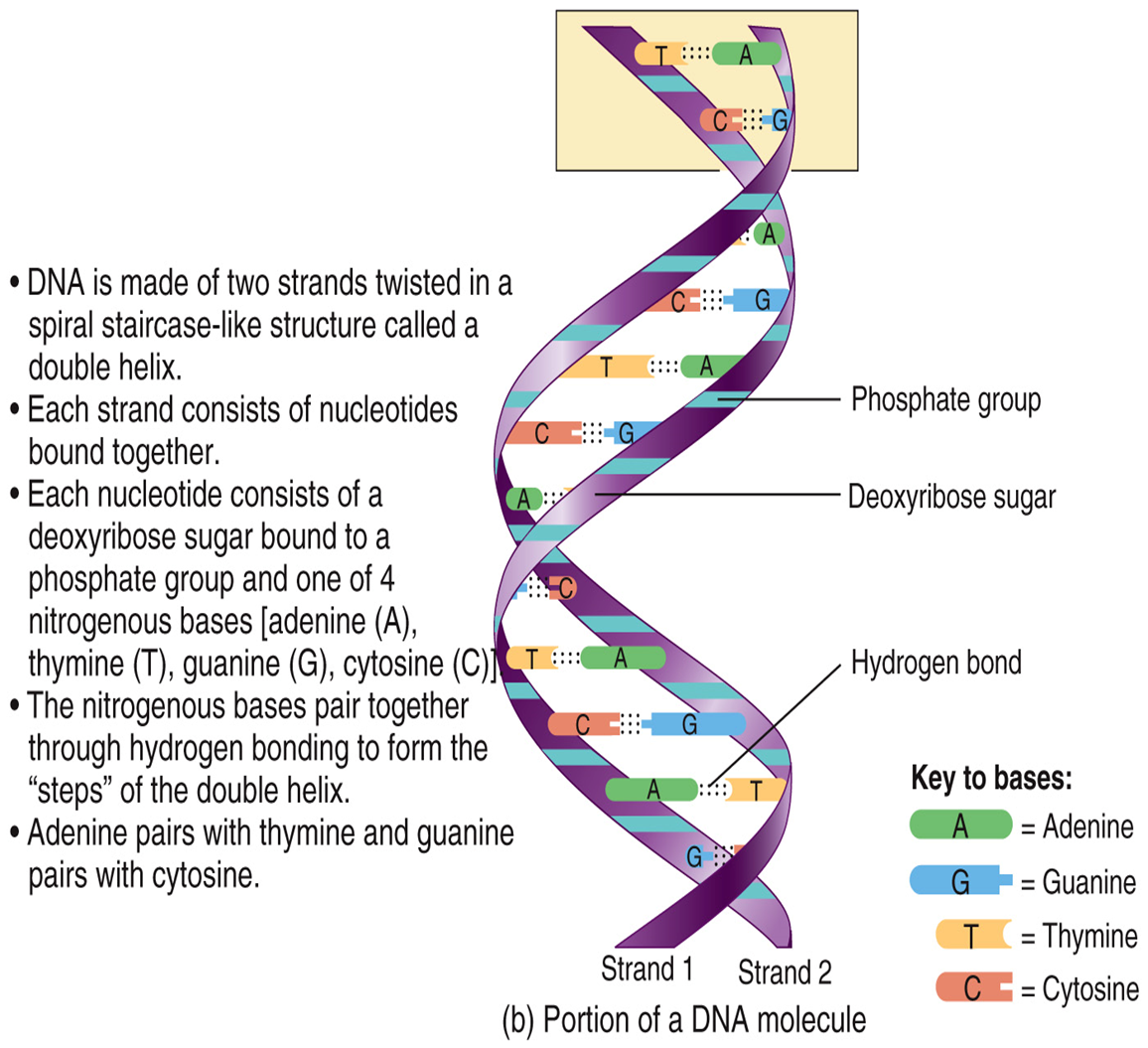
D N A

Slide 100
D N A vs. R N A
Feature | DNA | RNA
Nitrogenous bases | Adenine (A), cytosine (C), guanine (G), thymine (T). | Adenine (A), cytosine (C), guanine (G), uracil (U).
Sugar in nucleotides | Deoxyribose. | Ribose.
Number of strands | Two (double-helix, like a twisted ladder). | One.
Nitrogenous base pairing (number of hydrogen bonds) | A with T (2), G with C (3). | A with U (2), G with C (3).
How is it copied? | Self-replicating. | Made by using DNA as a blueprint.
Function | Encodes information for making proteins. | Carries the genetic code and assists in making proteins.
Types | Nuclear, mitochondrial. | Messenger RNA (mRNA), transfer

Slide 101
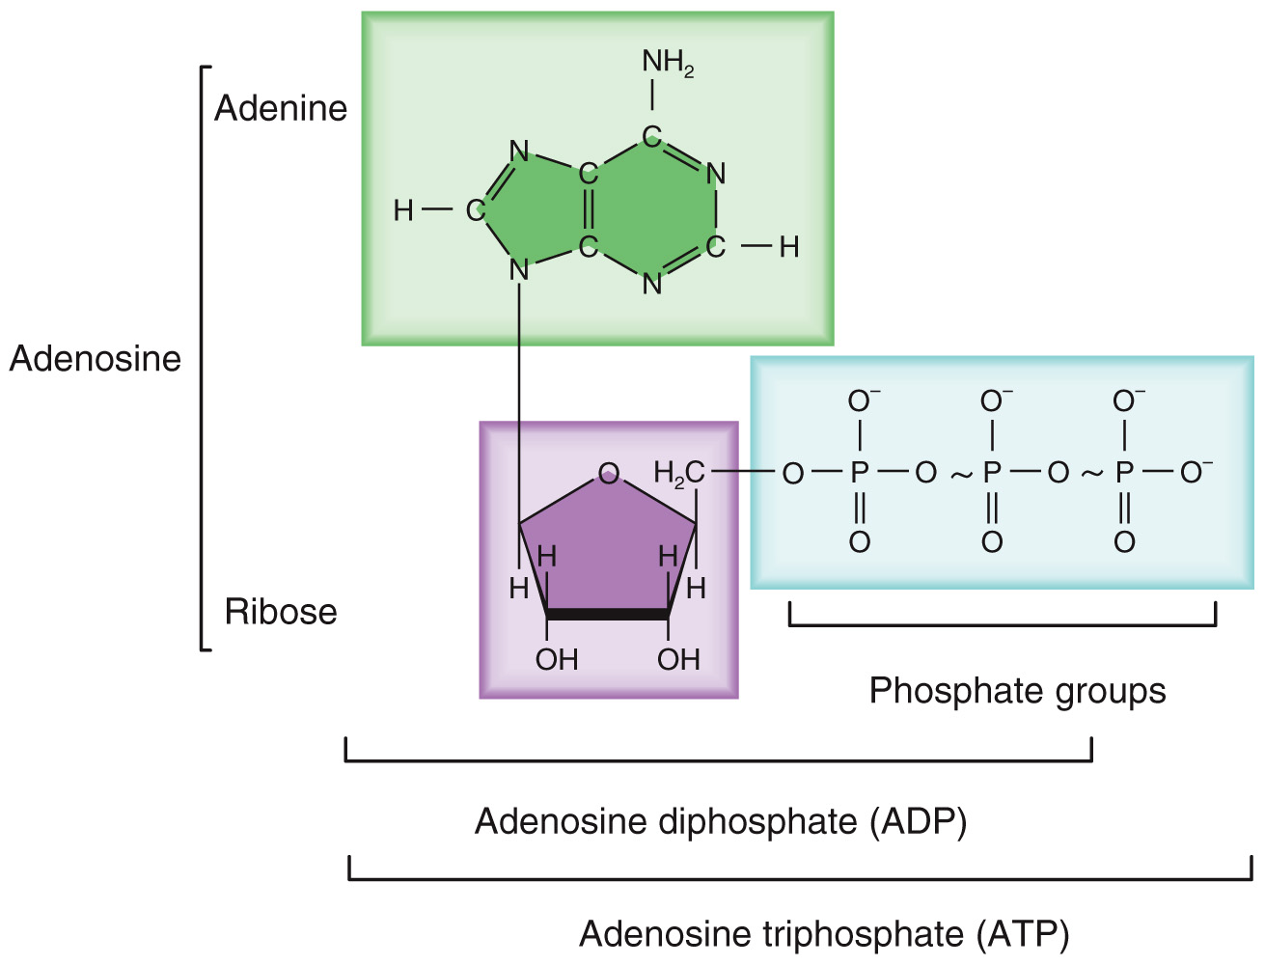
Adenosine Triphosphate (A T P)
ATP is the principal energy-providing molecule in the body
Since phosphates are negatively-charged, they repel one another
Results in ATP being an unstable molecule
This is why energy must be stored in a more stable form – carbohydrates and fats

Slide 102
How Does The Cell Produce ATP?
Cellular respiration is when glucose is catabolized
Releases energy to remove phosphate to form ADP
Two phases
Anaerobic (without oxygen); glucose partially broken down into pyruvic acid; yields 2 ATP
Aerobic (requires oxygen); glucose broken into CO₂ and H₂O); yields 30-32 ATP
Chapters 10 and 25 cover respiration

Slide 103
Copyright
Copyright © 2021 John Wiley & Sons, Inc.
All rights reserved. Reproduction or translation of this work beyond that permitted in Section 117 of the 1976 United States Copyright Act without the express written permission of the copyright owner is unlawful. Request for further information should be addressed to the Permissions Department, John Wiley & Sons, Inc. The purchaser may make back-up copies for his/her own use only and not for distribution or resale. The Publisher assumes no responsibility for errors, omissions, or damages caused by the use of these programs or from the use of the information contained herein.

